Slide 1

8th Grade Math: Pre-Algebra
Unit 4, Lesson 1 Negative Exponent Law Volume 1, pg. 123

Slide 2


Benchmark
MA.8.NSO.1.3
Extend previous understanding of the Laws of Exponents to include integer exponents. Apply the Laws of Exponents to evaluate numerical expressions and generate equivalent numerical expressions, limited to integer exponents and rational number bases, with procedural fluency.
volume 1, pg. 123

Slide 3
Integrated Mathematical Thinking and Reasoning Standards
MA.K12.MTR.1.1 Actively participate in effortful learning both individually and collectively.
MA.K12.MTR.2.1 Demonstrate understanding by representing problems in multiple ways.
MA.K12.MTR.3.1 Complete tasks with mathematical fluency.
MA.K12.MTR.5.1 Use patterns and structure to help understand and connect mathematical concepts.
volume 1, pg. 123

Slide 4

Learning Targets
I can apply the laws of exponents to evaluate numerical expressions with integer exponents.
I can generate equivalent numerical expressions using the laws of exponents for expressions with integer exponents.
volume 1, pg. 123

Slide 5

Warm-Up
volume 1, pg. 123

Slide 6
4.1.1 Warm-Up: Day at Work with a Fish Biologist
Moises, an ichthyologist, or fish biologist, says, “Try to be in touch with a system that you really want to study, with a system that really drives you crazy, because that’s how you nurture passion and passion is one of the most important things in becoming a researcher.”
What is something that you are passionate about?
Why do you think he says that passion is one of the most important things in becoming a researcher?
volume 1, pg. 123
Notes:
Video Link: https://algebranation.wistia.com/medias/fi4fidi5y8

Slide 7

Refresher
volume 1, pg. 124

Slide 8

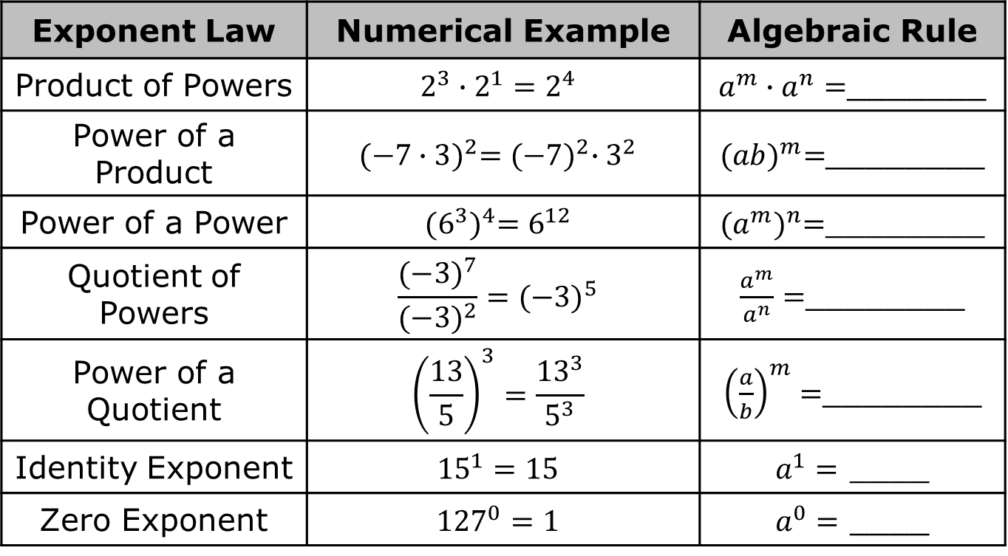
4.1.2 Refresher: Laws of Exponents
Complete the rule for each exponent law shown.
Exponent Law | Numerical Example | Algebraic Rule
Product of Powers | $$2^{3}∙2^{1}=2^{4}$$ | $a^{m}∙a^{n}=$_______
Power of a Product | $${(−7∙3)}^{2}={(−7)}^{2}∙3^{2}$$ | ${(ab)}^{m}=$________
Power of a Power | $${(6^{3})}^{4}=6^{12}$$ | ${(a^{m})}^{n}=$________
Quotient of Powers | $$\frac{{(−3)}^{7}}{{(−3)}^{2}}={(−3)}^{5}$$ | $\frac{a^{m}}{a^{n}}=$________
Power of a Quotient | $${\left(\frac{13}{5}\right)}^{3}=\frac{{13}^{3}}{5^{3}}$$ | ${\left(\frac{a}{b}\right)}^{m}=$________
Identity Exponent | $${15}^{1}=15$$ | $a^{1}=$ ____
Zero Exponent | $${127}^{0}=1$$ | $a^{0}=$ ____
volume 1, pg. 124

Slide 9
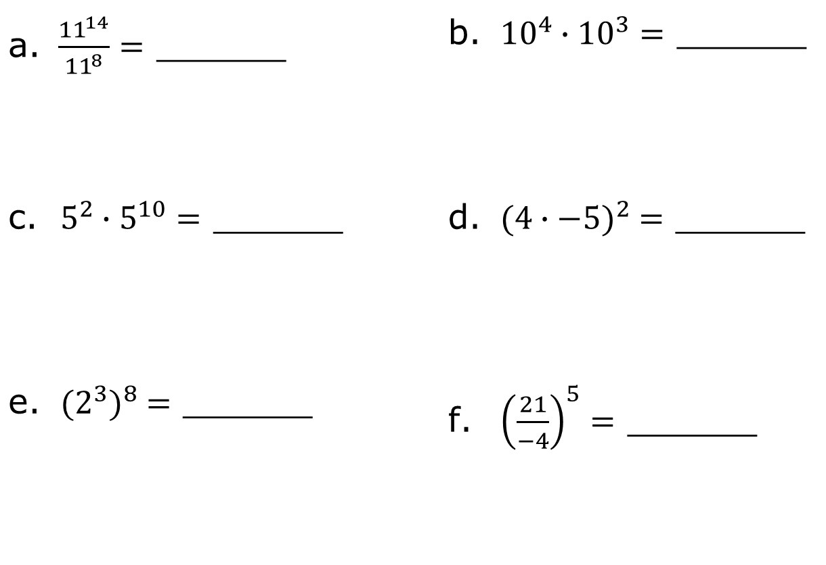
Write an equivalent exponential expression by applying the laws of exponents.
$\frac{{11}^{14}}{{11}^{8}}=$ ______ | ${10}^{4}∙{10}^{3}=$ ______
$5^{2}∙5^{10}=$ ______ | ${(4∙−5)}^{2} =$ ______
${(2^{3})}^{8} =$ ______ | ${\left(\frac{21}{−4}\right)}^{5}=$ ______
volume 1, pg. 124

Slide 10

Exploration
volume 1, pg. 124

Slide 11

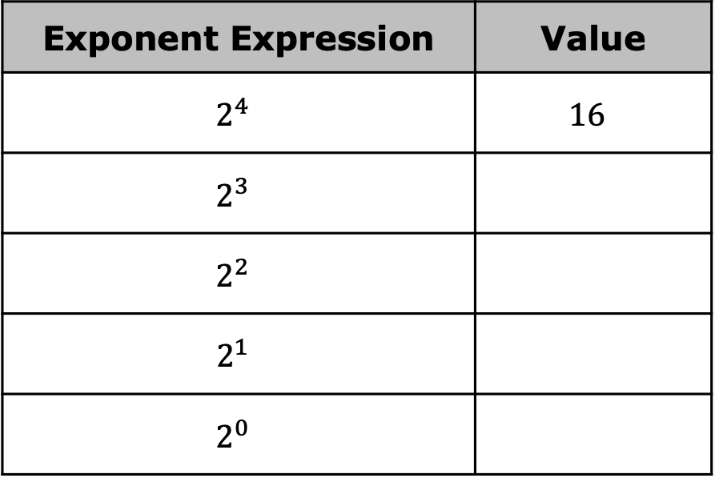
4.1.3 Exploration: Finding Patterns to Evaluate Numeric Expressions with Exponents
Work with your partner to complete the following.
Complete the table.
Exponent Expression | Value
$$2^{4}$$ | $$16$$
$$2^{3}$$
$$2^{2}$$
$$2^{1}$$
$$2^{0}$$
volume 1, pg. 124

Slide 12
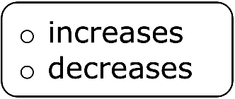
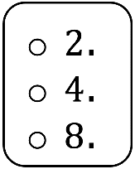
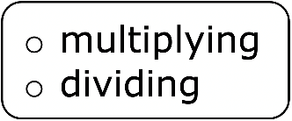
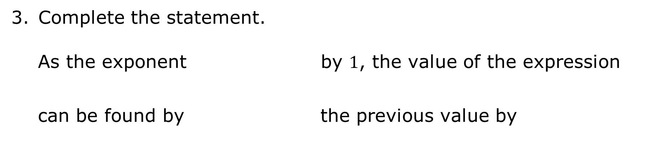
Describe any mathematical pattern(s) you notice regarding how the values of the expressions change as the exponent changes.
Complete the statement.
As the exponent by $1$, the value of the expression can be found by the previous value by
volume 1, pg. 124

Slide 13
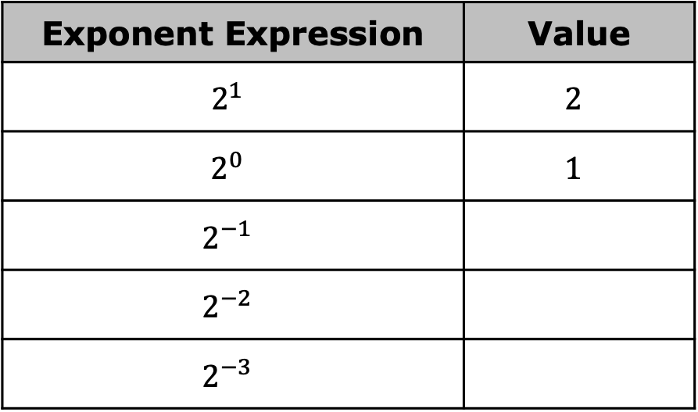
Continue the pattern to complete the table.
Exponent Expression | Value
$$2^{1}$$ | $$2$$
$$2^{0}$$ | $$1$$
$$2^{−1}$$
$$2^{−2}$$
$$2^{−3}$$
Compare the values of $2^{3}$ and $2^{−3}$. What do you notice?
volume 1, pg. 125

Slide 14
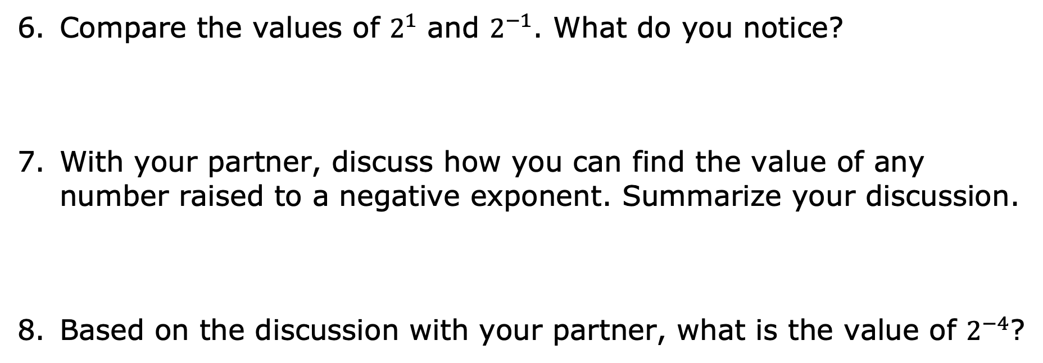
Compare the values of $2^{1}$ and $2^{−1}$. What do you notice?
With your partner, discuss how you can find the value of any number raised to a negative exponent. Summarize your discussion.
Based on the discussion with your partner, what is the value of $2^{−4}$?
volume 1, pg. 125

Slide 15

Bring It Together
volume 1, pg. 125

Slide 16

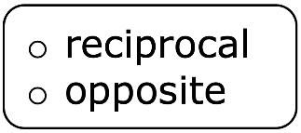
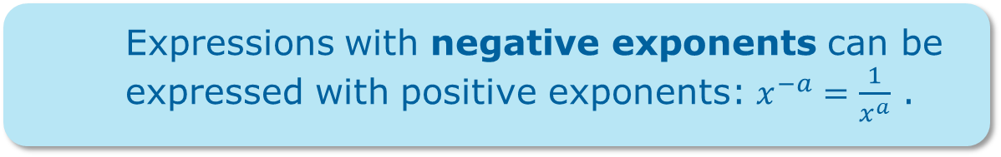
4.1.4 Bring It Together: Negative Exponents
Expressions with negative exponents can be expressed with positive exponents: $x^{−a}=\frac{1}{x^{a}}$ .
Complete the statement.
A base with a negative exponent can be rewritten using the of the base with the exponent.
volume 1, pg. 125

Slide 17

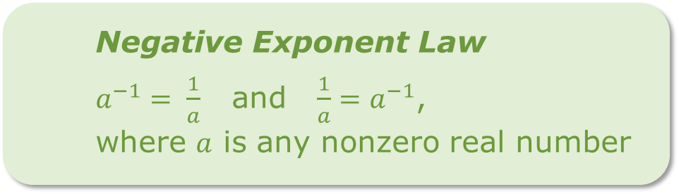
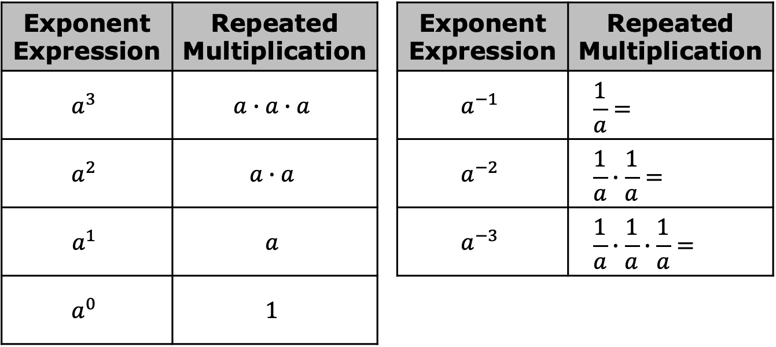
Complete the table.
Exponent Expression | Repeated Multiplication |  | Exponent Expression | Repeated Multiplication
$$a^{3}$$ | $$a∙a∙a$$ |  | $$a^{−1}$$ | $$\frac{1}{a}=$$
$$a^{2}$$ | $$a∙a$$ |  | $$a^{−2}$$ | $$\frac{1}{a}∙\frac{1}{a}=$$
$$a^{1}$$ | $$a$$ |  | $$a^{−3}$$ | $$\frac{1}{a}∙\frac{1}{a}∙\frac{1}{a}=$$
$$a^{0}$$ | $$1$$
Negative Exponent Law
$a^{−1}= \frac{1}{a}$ and $\frac{1}{a}=a^{−1}$, where $a$ is any nonzero real number
volume 1, pg. 126

Slide 18

Guided Practice
volume 1, pg. 126

Slide 19


4.1.5 Guided Practice: Rewriting Negative Exponents
Rewrite each expression as an equivalent exponential expression using positive exponents.
$8^{−3}= ______$
$\frac{1}{{−4}^{−5}} = ______$
${\left(−2\right)}^{−8} = ______$
volume 1, pg. 126

Slide 20

$\frac{1}{{10}^{−2}} =_________$
$−5∙6^{−4}= _________$
$\frac{2^{−3}}{9^{−2}}= _________$
volume 1, pg. 126

Slide 21

Collaboration
volume 1, pg. 127

Slide 22

4.1.6 Collaboration: Applying Other Exponent Laws with Negative Exponents
Work with your partner to complete the following.
Consider the exponential expressions in the table.
For each expression, work with your partner to rewrite the exponential expression in expanded form and evaluate. The first row has been partially completed.
volume 1, pg. 127

Slide 23
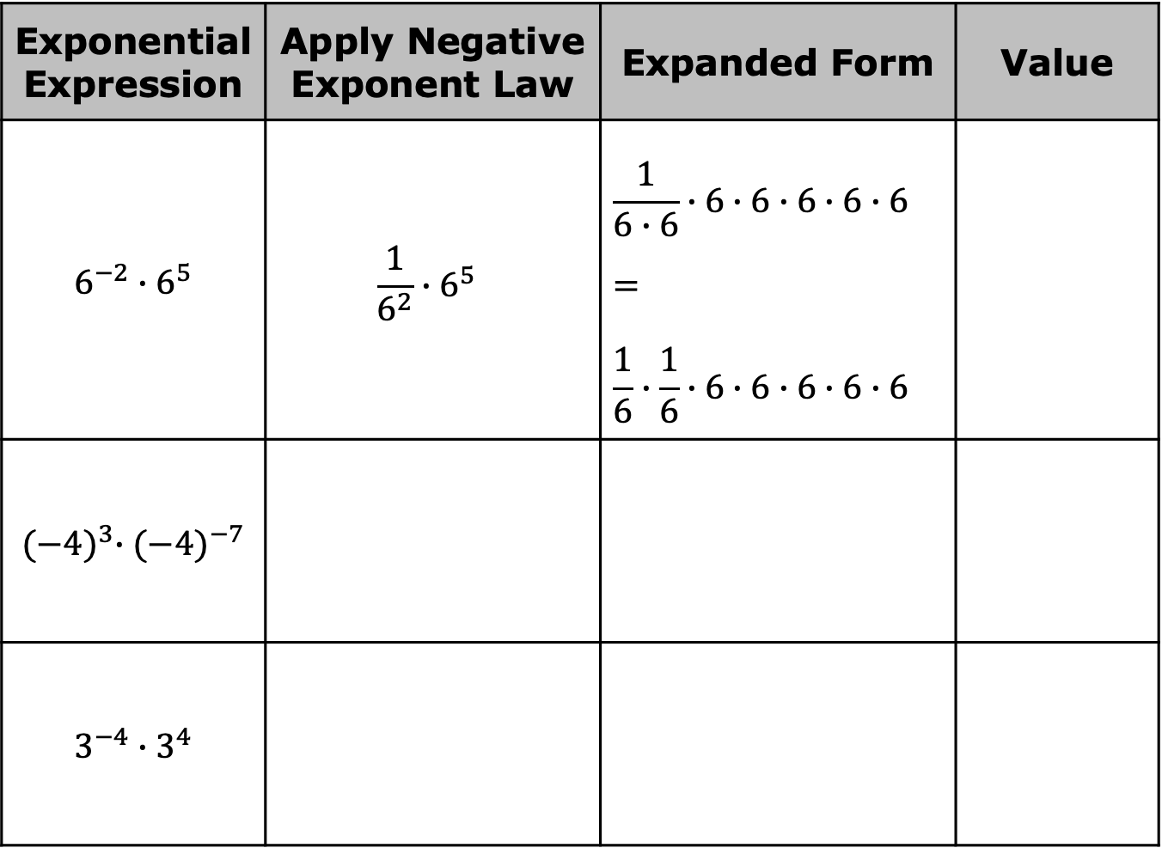
Exponential Expression | Apply Negative Exponent Law | Expanded Form | Value
$$6^{−2}∙6^{5}$$ | $$\frac{1}{6^{2}}∙6^{5}$$ | $$\frac{1}{6∙6}∙6∙6∙6∙6∙6= \\ \frac{1}{6}∙\frac{1}{6}∙6∙6∙6∙6∙6$$
$${(−4)}^{3}∙{(−4)}^{−7}$$
$$3^{−4}∙3^{4}$$
volume 1, pg. 127

Slide 24
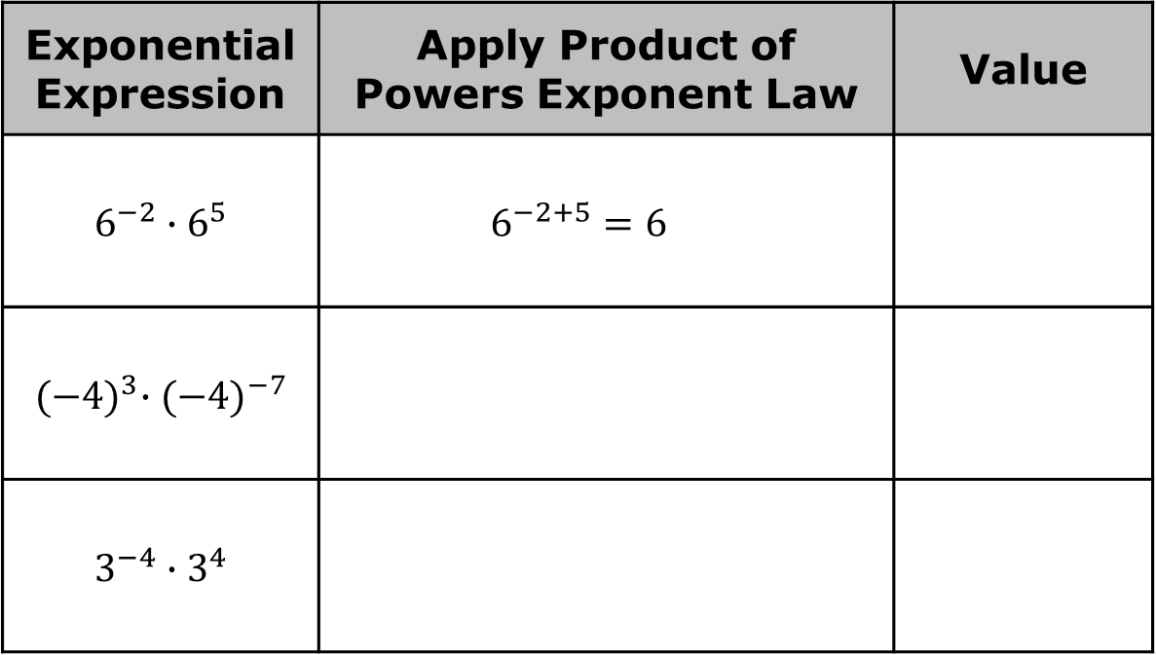
Complete the table to evaluate each expression by applying the product of powers law.
Exponential Expression | Apply Product of Powers Exponent Law | Value
$$6^{−2}∙6^{5}$$ | $$6^{−2+5}=6^{ }$$
$${(−4)}^{3}∙{(−4)}^{−7}$$
$$3^{−4}∙3^{4}$$
With your partner, discuss your observations of the tables from Parts A and B.
volume 1, pg. 127

Slide 25
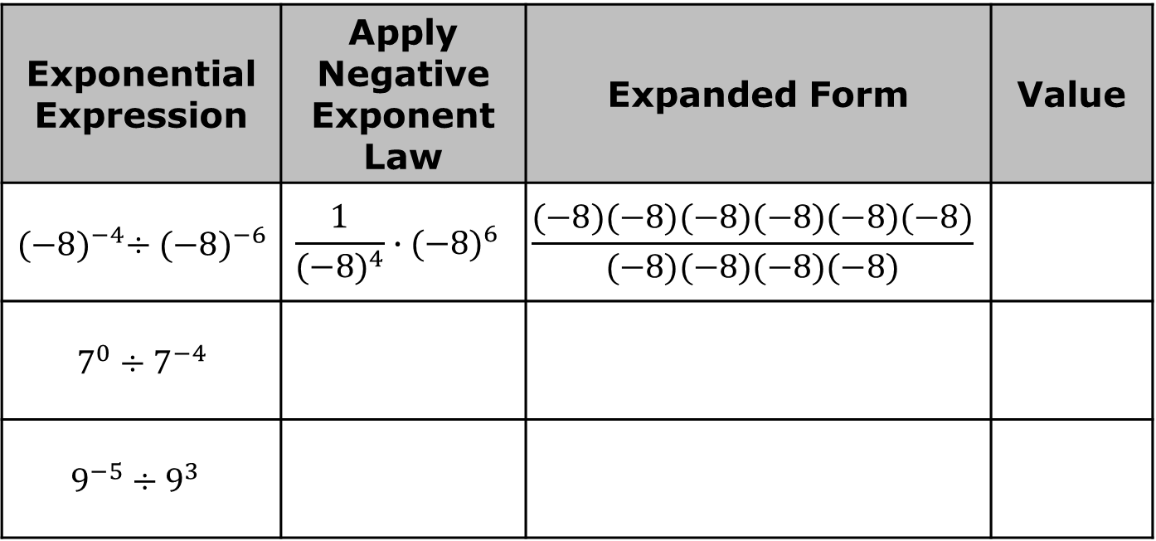
Consider the exponential expressions in the table.
For each expression, work with your partner to rewrite the exponential expression in expanded form and evaluate. The first row has been partially completed.
Exponential Expression | Apply Negative Exponent Law | Expanded Form | Value
${(−8)}^{−4}÷{(−8)}^{−6}$ | $$\frac{1}{{(−8)}^{4}}∙{(−8)}^{6}$$ | $$\frac{(−8)(−8)(−8)(−8)(−8)(−8)}{(−8)(−8)(−8)(−8)}$$
$7^{0}÷7^{−4}$
$$9^{−5}÷9^{3}$$
volume 1, pg. 128

Slide 26
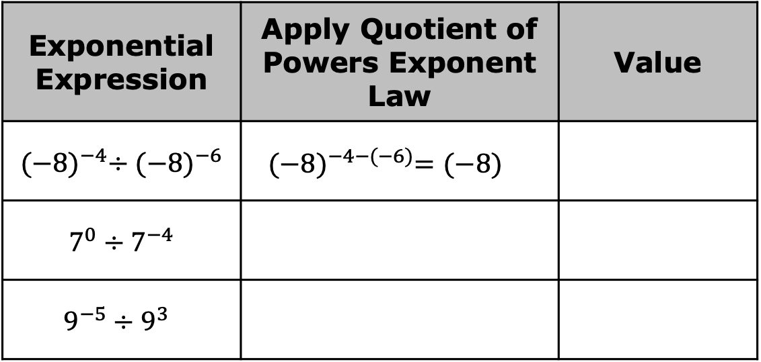
Complete the table to evaluate each expression by applying quotient of powers law.
Exponential Expression | Apply Quotient of Powers Exponent Law | Value
${(−8)}^{−4}÷{(−8)}^{−6}$ | ${(−8)}^{−4−(−6)}={(−8)}^{ }$
$7^{0}÷7^{−4}$
$$9^{−5}÷9^{3}$$
With your partner, discuss your observations of the tables after completing Parts A and B.
volume 1, pg. 128

Slide 27
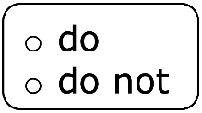
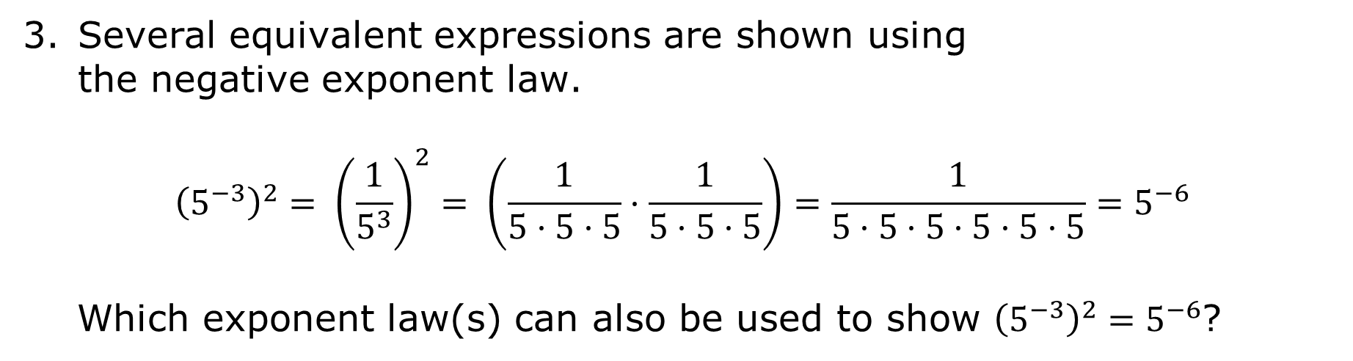
Several equivalent expressions are shown using the negative exponent law.
$${\left(5^{−3}\right)}^{2}= {\left(\frac{1}{5^{3}}\right)}^{2}= \left(\frac{1}{5·5·5}·\frac{1}{5·5·5}\right)=\frac{1}{5·5·5·5·5·5}=5^{−6}$$
Which exponent law(s) can also be used to show ${{\left(5^{−3}\right)}^{2}=5}^{−6}$?
Complete the statement.
The laws of exponents hold true for numeric expressions with rational bases and negative exponents.
volume 1, pg. 128

Slide 28

Wrap-Up
volume 1, pg. 129

Slide 29
4.1.7 Wrap-Up: Growth Mindset
Complete each statement based on today’s lesson.
Today I am still unsure about …
I will try to build my confidence by …
volume 1, pg. 129

